Slide 1
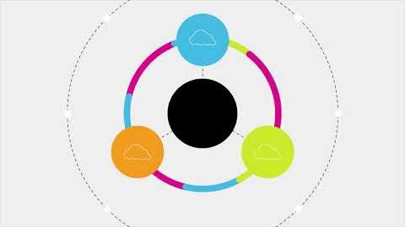
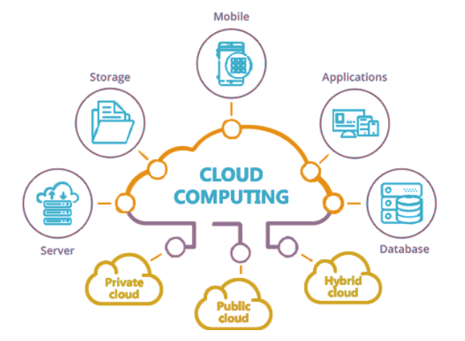
what is Cloud Computing
Cloud computing is the delivery of different services through the Internet. These resources include tools and applications like data storage, servers, databases, networking, and software.
Rather than keeping files on a proprietary hard drive or local storage device, cloud-based storage makes it possible to save them to a remote database. As long as an electronic device has access to the web, it has access to the data and the software programs to run it.
Cloud computing is a popular option for people and businesses for a number of reasons including cost savings, increased productivity, speed and efficiency, performance, and security.

Slide 2
Features of Cloud Computing
1. Resources Pooling
It means that the Cloud provider pulled the computing resources to provide services to multiple customers with the help of a multi-tenant model. There are different physical and virtual resources assigned and reassigned which depends on the demand of the customer. The customer generally has no control or information over the location of the provided resources but is able to specify location at a higher level of abstraction
2. On-Demand Self-Service
It is one of the important and valuable features of Cloud Computing as the user can continuously monitor the server uptime, capabilities, and allotted network storage. With this feature, the user can also monitor the computing capabilities.
3. Easy Maintenance
The servers are easily maintained and the downtime is very low and even in some cases, there is no downtime. Cloud Computing comes up with an update every time by gradually making it better. The updates are more compatible with the devices and perform faster than older ones along with the bugs which are fixed.
4. Large Network Access
The user can access the data of the cloud or upload the data to the cloud from anywhere just with the help of a device and an internet connection. These capabilities are available all over the network and accessed with the help of internet.
5. Availability
The capabilities of the Cloud can be modified as per the use and can be extended a lot. It analyzes the storage usage and allows the user to buy extra Cloud storage if needed for a very small amount.

Slide 3
Features of Cloud Computing
6. Automatic System
Cloud computing automatically analyzes the data needed and supports a metering capability at some level of services. We can monitor, control, and report the usage. It will provide transparency for the host as well as the customer.
7. Economical
It is the one-time investment as the company (host) has to buy the storage and a small part of it can be provided to the many companies which save the host from monthly or yearly costs. Only the amount which is spent is on the basic maintenance and a few more expenses which are very less.
8. Security
Cloud Security, is one of the best features of cloud computing. It creates a snapshot of the data stored so that the data may not get lost even if one of the servers gets damaged. The data is stored within the storage devices, which cannot be hacked and utilized by any other person. The storage service is quick and reliable.
9. Pay as you go
In cloud computing, the user has to pay only for the service or the space they have utilized. There is no hidden or extra charge which is to be paid. The service is economical and most of the time some space is allotted for free.
10. Measured Service
Cloud Computing resources used to monitor and the company uses it for recording. This resource utilization is analyzed by supporting charge-per-use capabilities. This means that the resource usages which can be either virtual server instances that are running in the cloud are getting monitored measured and reported by the service provider. The model pay as you go is variable based on actual consumption of the manufacturing organization.

Slide 4
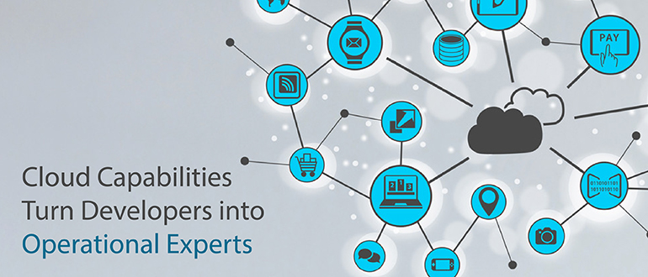
capabilities of Cloud Computing
Controlled Interface
The capacity for the integrated infrastructure to be responsive to change. In particular the capability of APIs to allow the innovation of applications and services on top of the platform – and the demands of the platform owner in managing/controlling that innovation. This seems a very important point as platform owners business models are dependent upon the exploitation of the platform – ranging from an open platform (like MS-Windows) where Microsoft make money from selling the initial product license, to closed platforms (like Apple’s iPhone) where money is extracted from application purchase ontop.
2) Location Independence
The capacity for services and information assets to be controlled/exploited without reference to their location. This hooks into a range of themes – from the technical architecture of systems and their capacity for integration, to legislative demands for locations and safe-harbouring of information.
3) Sourcing Independence
This is connected with the concern for lock-in and the desire for organizations to move their application between cloud platforms. They usefully highlight however that lock-in should be evaluated within the company firewall as much as outside it. Companies should evaluate their ability to move between any IT sources and their IT services should be independent of the platform used.
4) Ubiquitous Access
This refers to the ability of a cloud service to be accessed from differing devices and platforms globally. However they rightly extend this to include access to application programming interfaces not simply web-site portal pages.

Slide 5
capabilities of Cloud Computing
5) Virtual Business Environments
Similar to the Virtual Machine – this perspective virtualizes and integrates tools which support specific major business capabilities. Another way to look at it is a suite of cloud-services and workflows which allow the realization of business processes/functions within a cloud type environment. By considering such VBE’s the paper hints at Business Process as a Service and the possibilities of cloud services which Transend basic service provision and directly link to business process – allowing the scalability and elasticity of cloud to link to Business process innovation.
6) Addressability and Traceability
This calls for the ability to verify the history, location and application of data in the cloud for traceability purposes and compliance issues. I would however argue that it is not simply a matter of ensuring trackability – but being able to manage the traces recorded. Our inherent assumptions of the desirability of traceability are incorrect – as Apple is learning through the problems of its desire to trace and record wiki-antena data on iPhones, or the legal challenge and sentence against Google for its (albeit unintended) recording of users WiFi signals within its Google Mapping activity in Europe. Lets remember that sometimes it is better to forget.
7) Rapid Elasticity
The self-service capability of scaling up services. Here the authors make an interesting point – highlighting the need for elasticity in IT Service AND in Contract. Simply having scalable services but pricing which is not reflective of this is challenging. These are important dimensions of the cloud – and add to the corpus of our knowledge. What is useful is that they are drawn from an analysis of vendor offering – and further that they provide a road-map for strategy. I would urge those interested to get hold of the paper which goes into much more detail on strategic approaches to Cloud and the need for specific IT skills to manage such services. What is particularly refreshing about the article is its focus on mashing together of services – treating Cloud as a patchwork of services rather then focusing too heavily on the individual components.

Slide 6
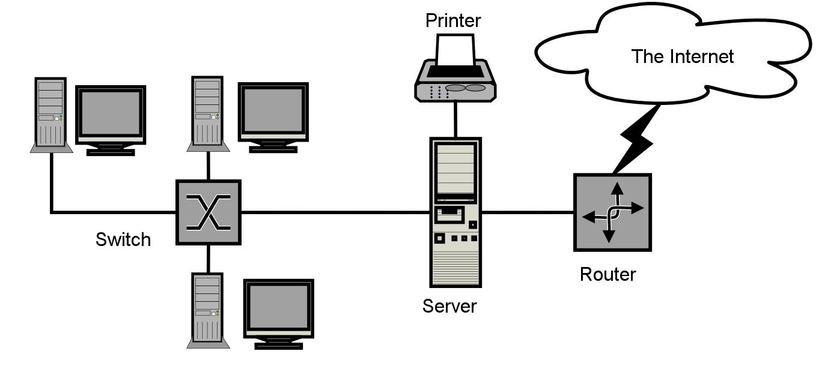
Learn more
https://www.zdnet.com/article/what-is-cloud-computing-everything-you-need-to-know-about-the-cloud/
https://azure.microsoft.com/en-in/overview/what-is-cloud-computing/
https://in.pcmag.com/networking-communications-software/38970/what-is-cloud-computing

